Slide 1
Traffic Sign Recognition
-By Team Dragonite
Khushil Modi
Sarjak Patel
Vishnu Vardhan Reddy Yeruva
Nevil Shah

Slide 2
Abstract
Traffic sign Recognition is a software application whose aim is to recognize traffic signs as efficiently as possible. This report tries to solve a major problem of Road Safety which is to classify traffic signs.
It also detects and filters the problem with the help of Convolution Neural Networks (CNNs) for image classification and delivers the accurate solution.
Traffic sign recognition software ensures that different types of traffic signs on both sides of the road are visible to the drivers while driving the car. This software can recognize different types of traffic signs like “Stop”,”School Ahead”,”Speed Limit”,”No parking” and many more.

Slide 3
Introduction
Nowadays, more emphasis and research is given on the ability of a car to drive itself on a road. It means it has to make accurate decisions while driving on a road or a highway to avoid collisions. Hence, it is very important to keep the conditions on either side of the road in mind. And the most important characteristic of a driverless car is to detect and recognize various traffic signs on the road for maintaining the safety and security of the people inside and outside the vehicle.
The Roadway system has different characteristics whose principal aim is to regulate and control the flow of traffic smoothly and to ensure that drivers are bound by the rules so as to provide a safe environment to the nearby traffic to avoid road collisions.

Slide 4
Implementation
German Traffic Sign Recognition Benchmark(GTSRB) dataset
For traffic sign recognition, we looked for dataset which contains images for traffic signs.This dataset consists of multi-class, single image classification images. Furthermore, this dataset consists of more than 40k images and 43 classes.
There are mainly 3 phases of this stage:
1)Data Preprocessing
2)Model Training
3)Model Testing
Link for the dataset:- https://www.kaggle.com/meowmeowmeowmeowmeow/gtsrb-german-traffic-sign

Slide 5
Requirements
Hardware Requirements
RAM: 8GB or more (16 GB Recommended)
CPU: I7 processor recommended
Storage:256 Gigabytes SSD
GPU: Nvidia NVS 310, GT, GTS, RTS (Recommended)
Software Requirements
Tensorflow
OpenCV
Access to Cloud platforms like Google Cloud platform, AWS Sagemaker.
IDEs like Spyder, Jupyter Notebook, Google Colab
Python v3.0.0 and above

Slide 6
Technology Used
Anaconda Navigator - Used to provide environment space for python/Jupyter lab
Python 3 / Jupyter notebook - Used for Training the data and as language to work and for pre-required libraries to fetch and use
Flask - For front-end implementation
Multiple Libraries - Numpy, pandas, tensorflow, sklearn,matplotlib,keras, openCV2
Pycharm - To provide IDE features and run the code with problem solving environment
Heroku - For software deployment

Slide 7
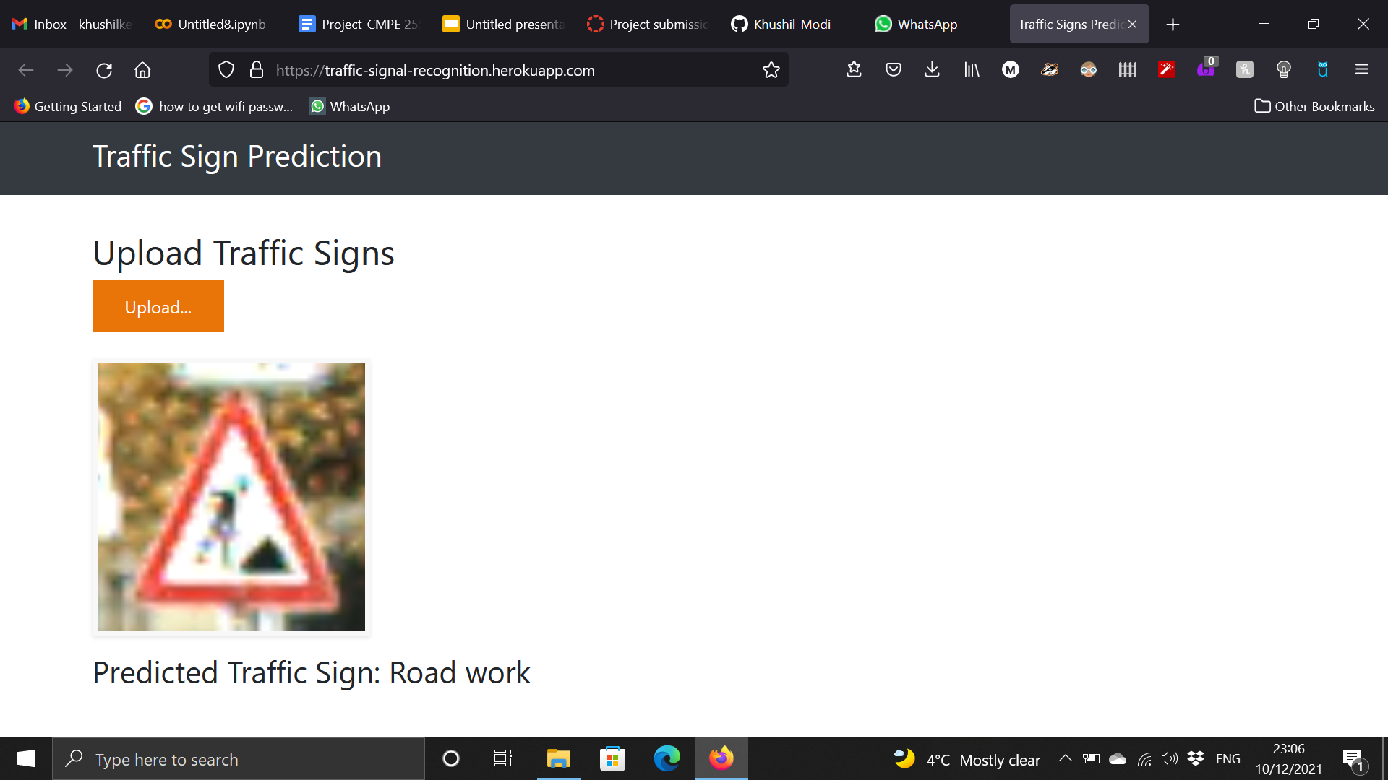
Testing Results

Slide 8
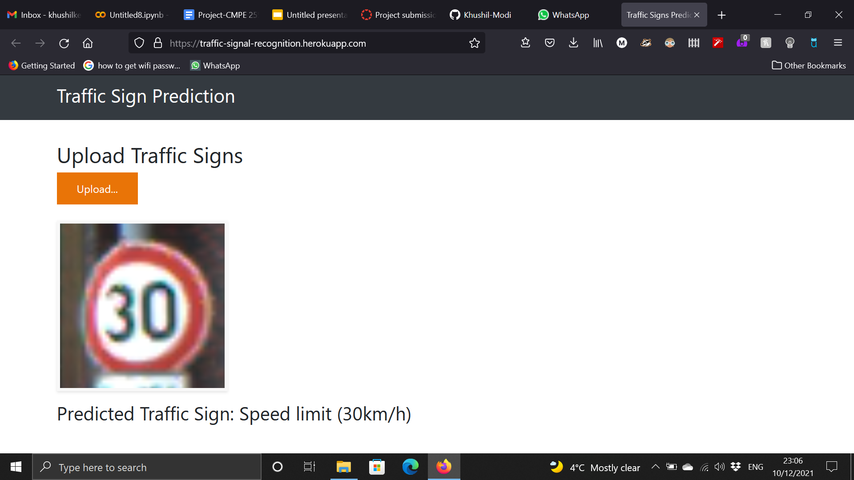

Slide 9
Thank you

